Slide 1
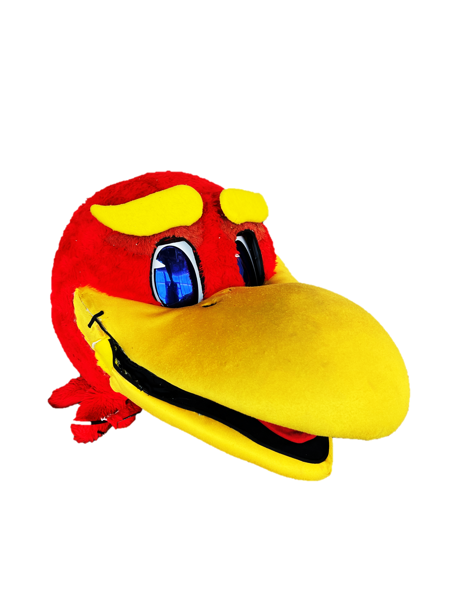
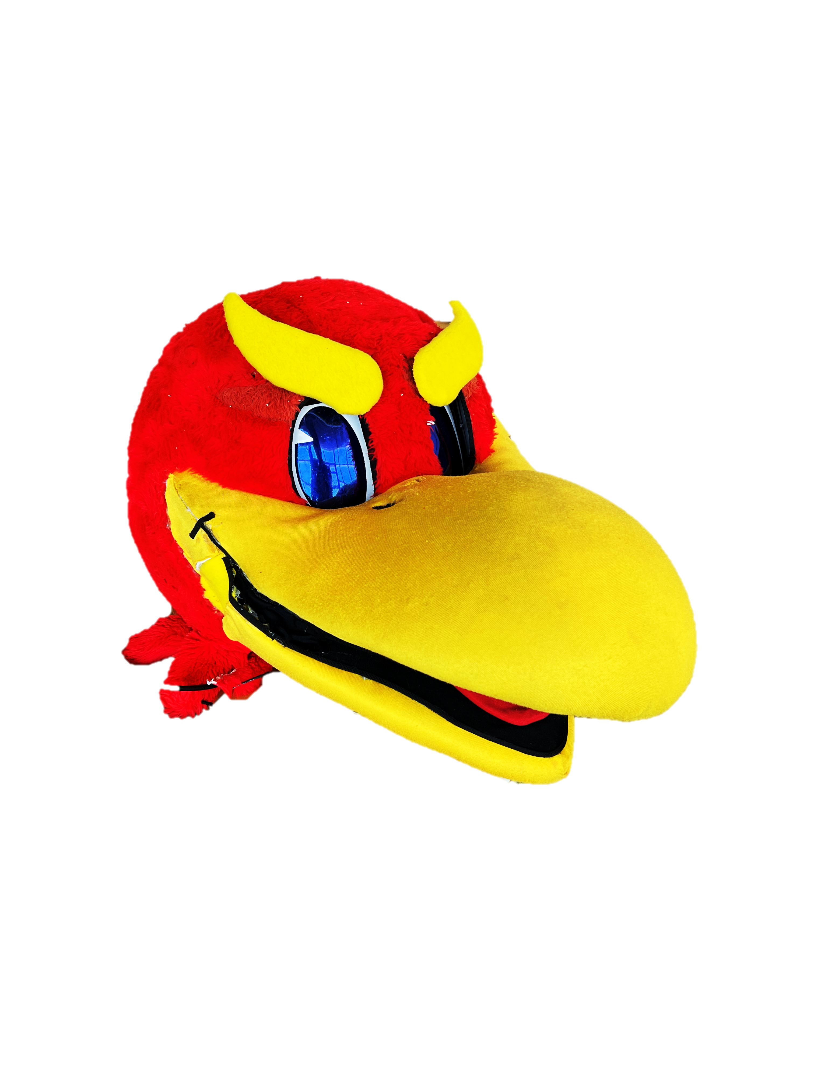
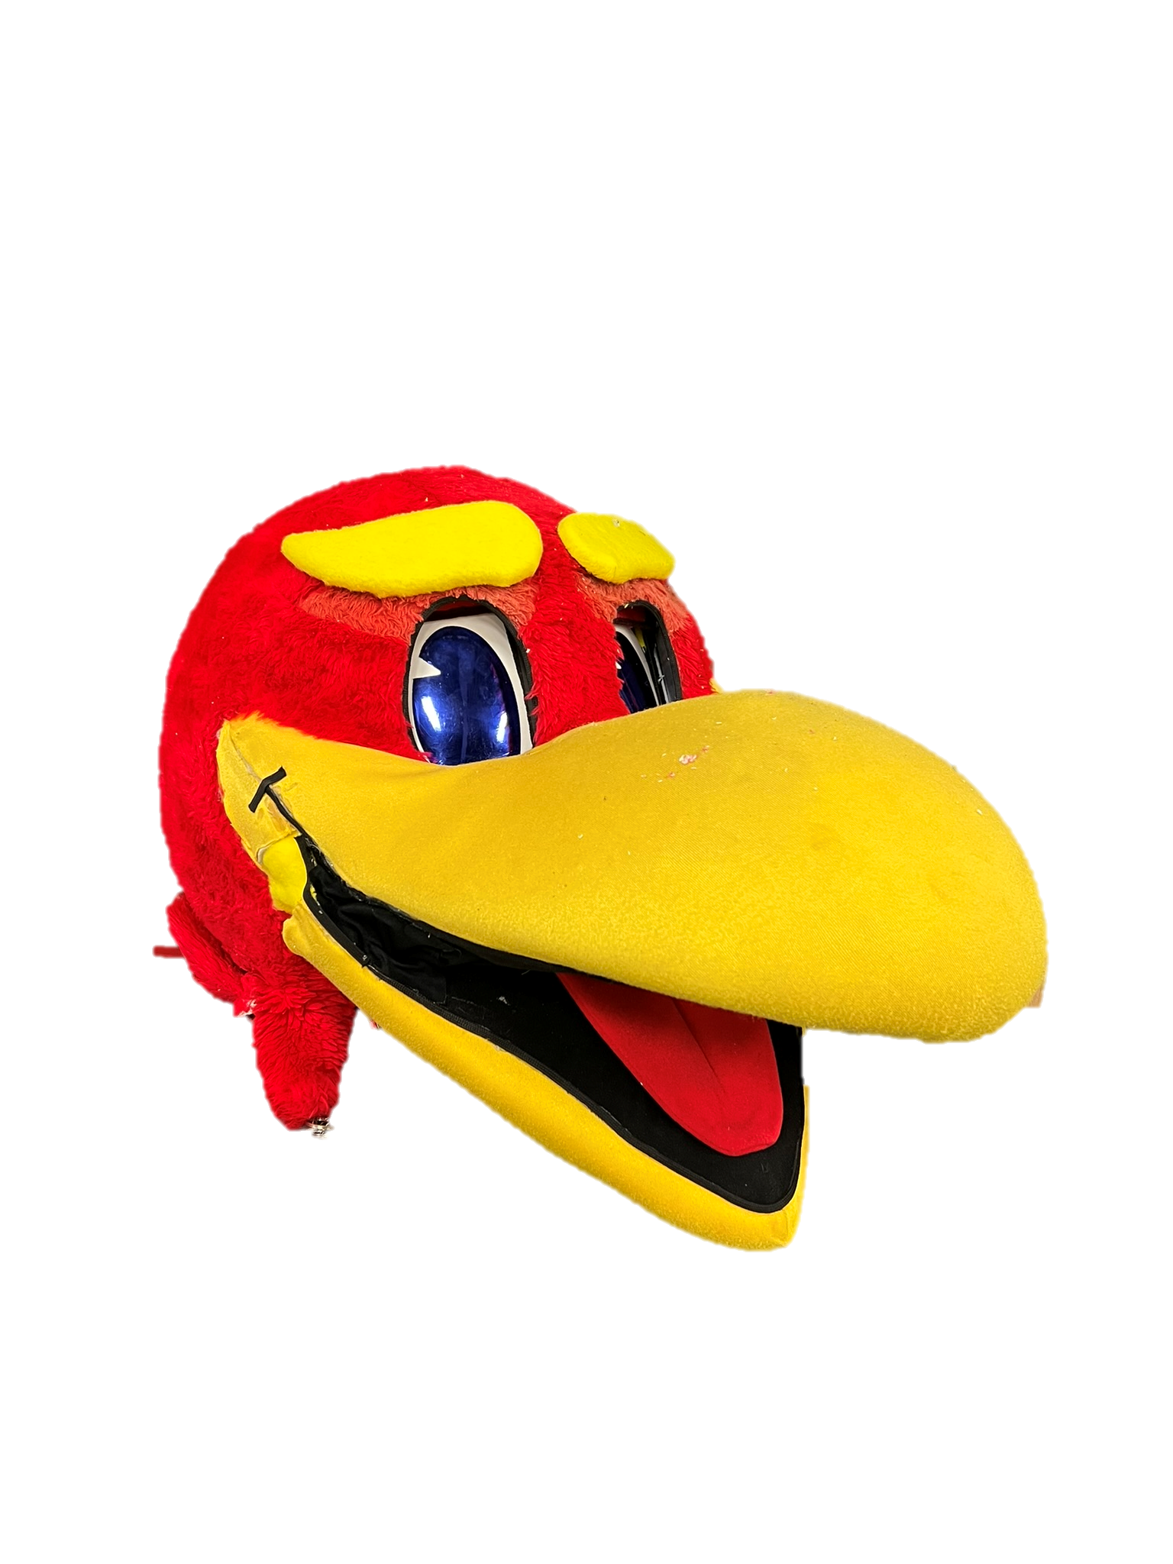
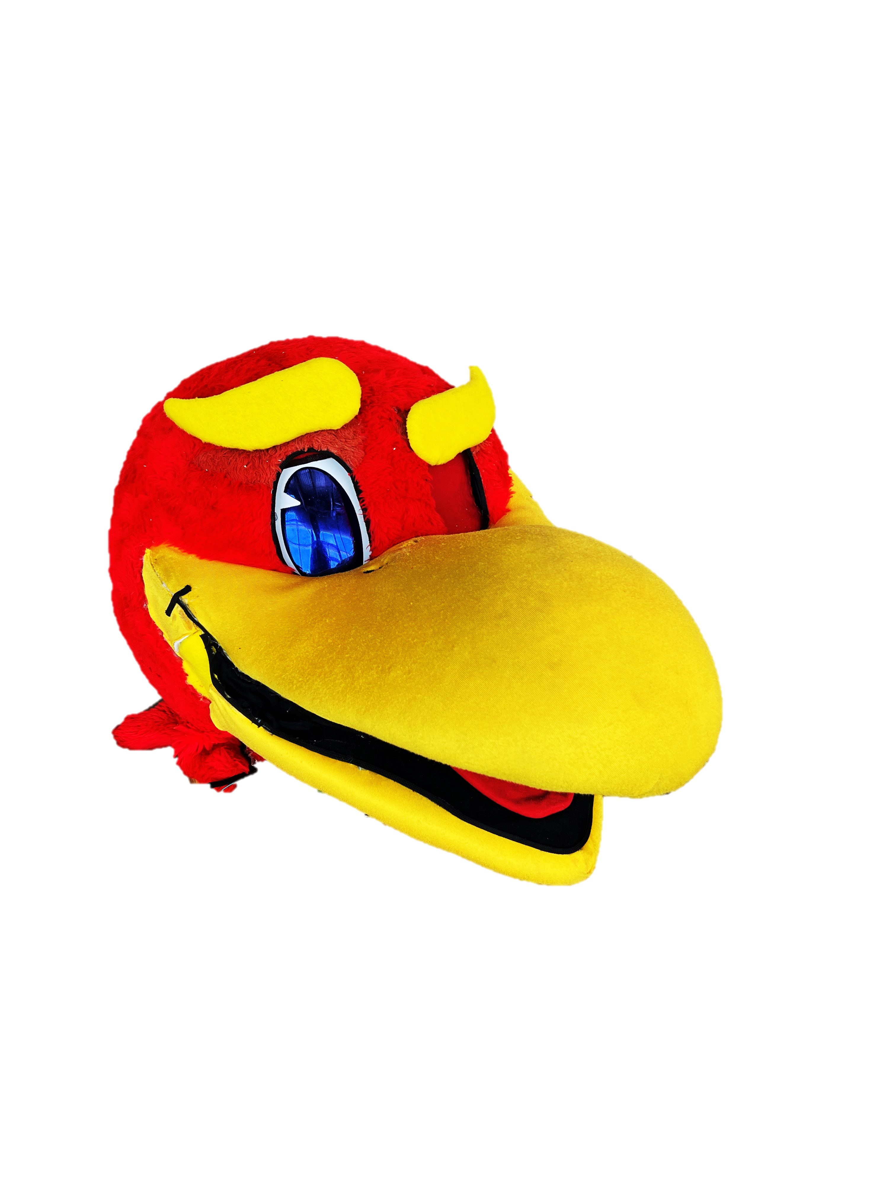

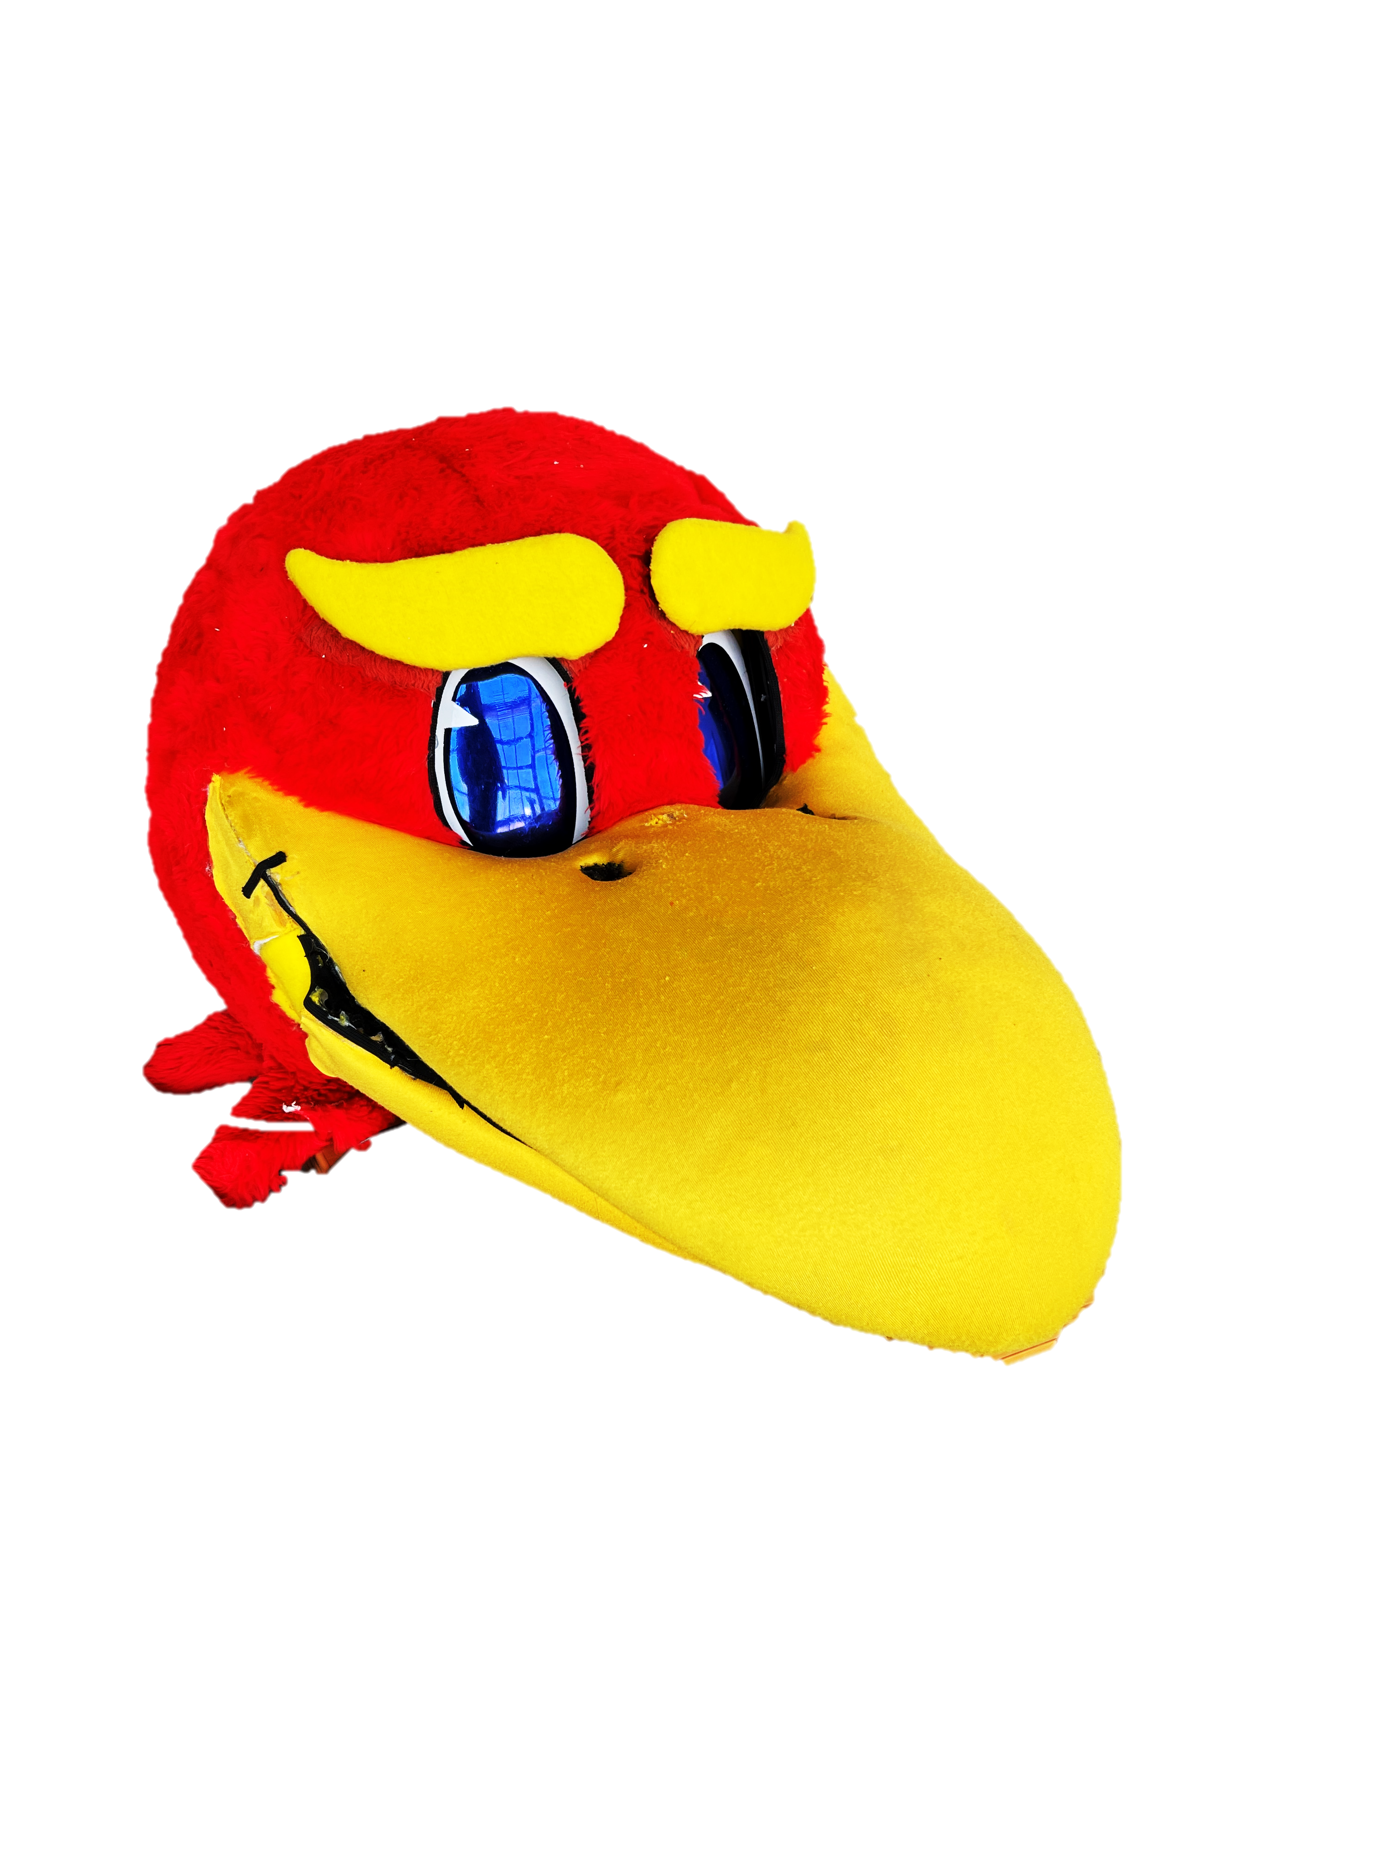
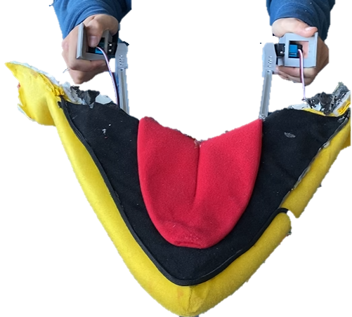
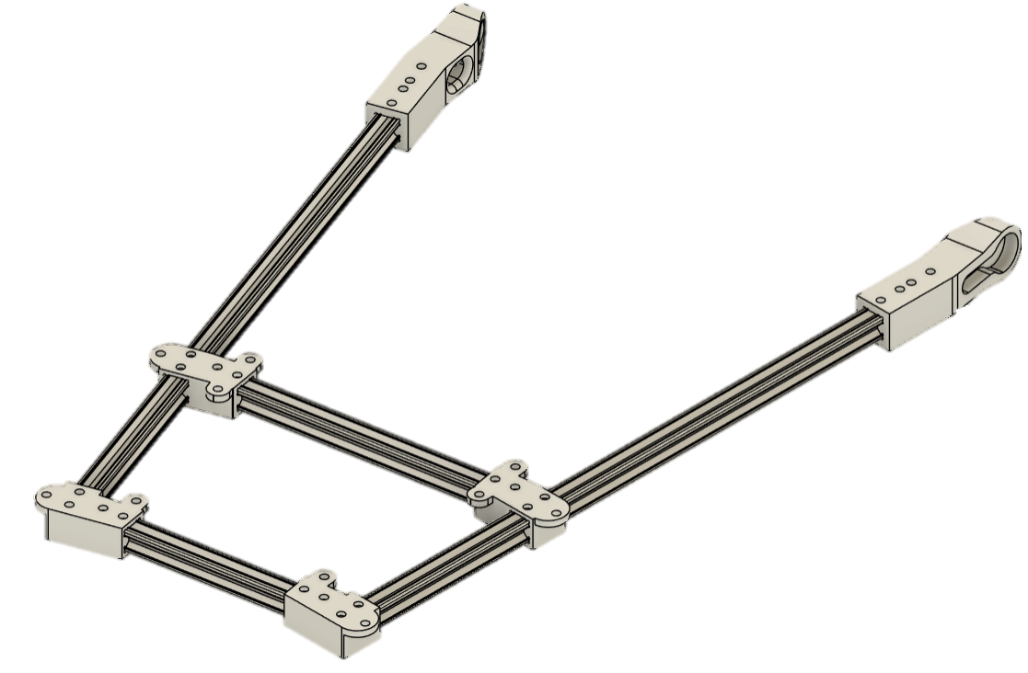
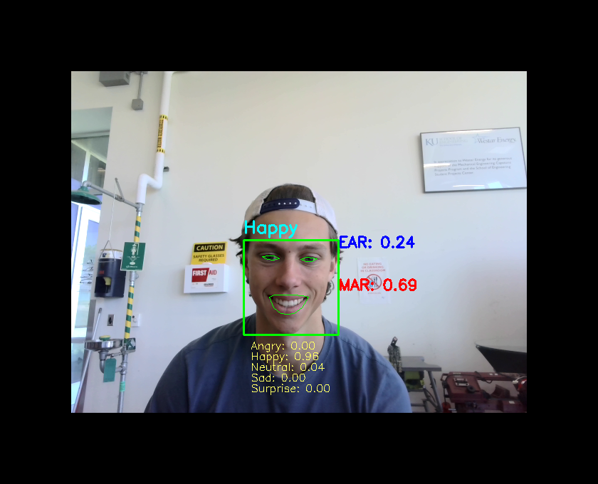
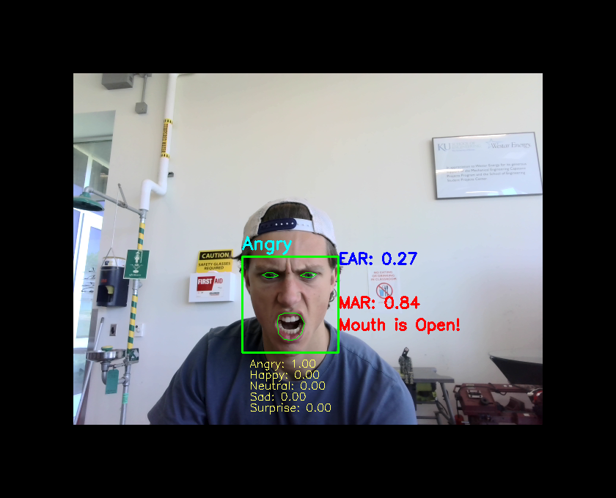

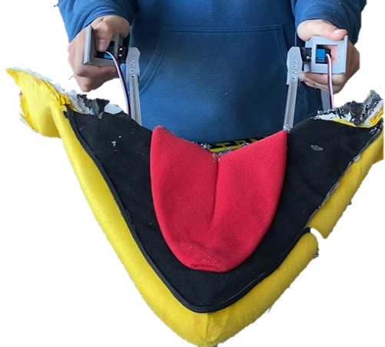
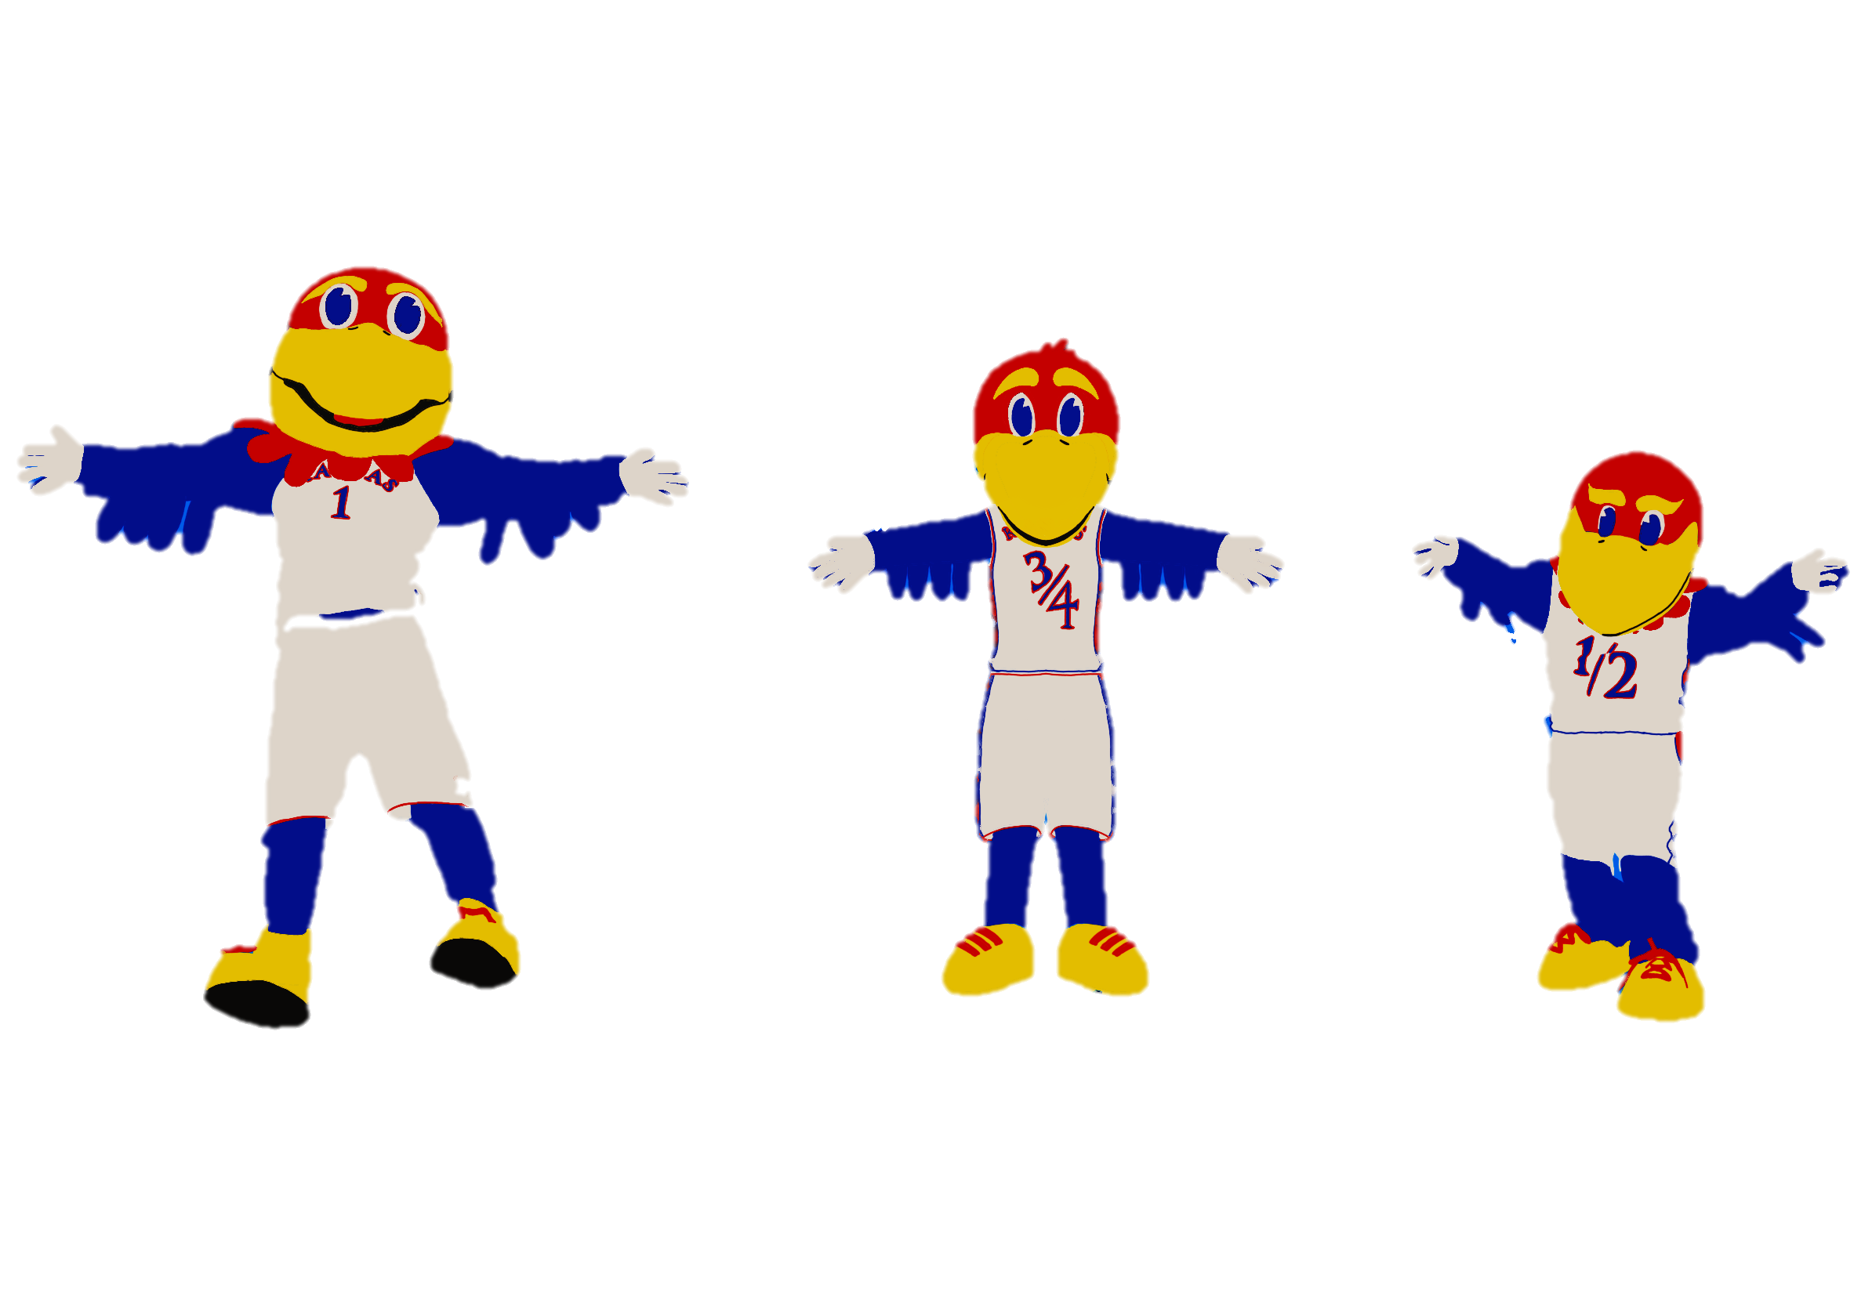
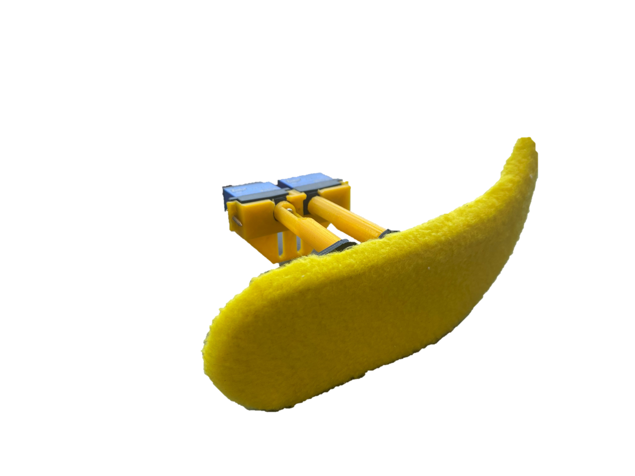
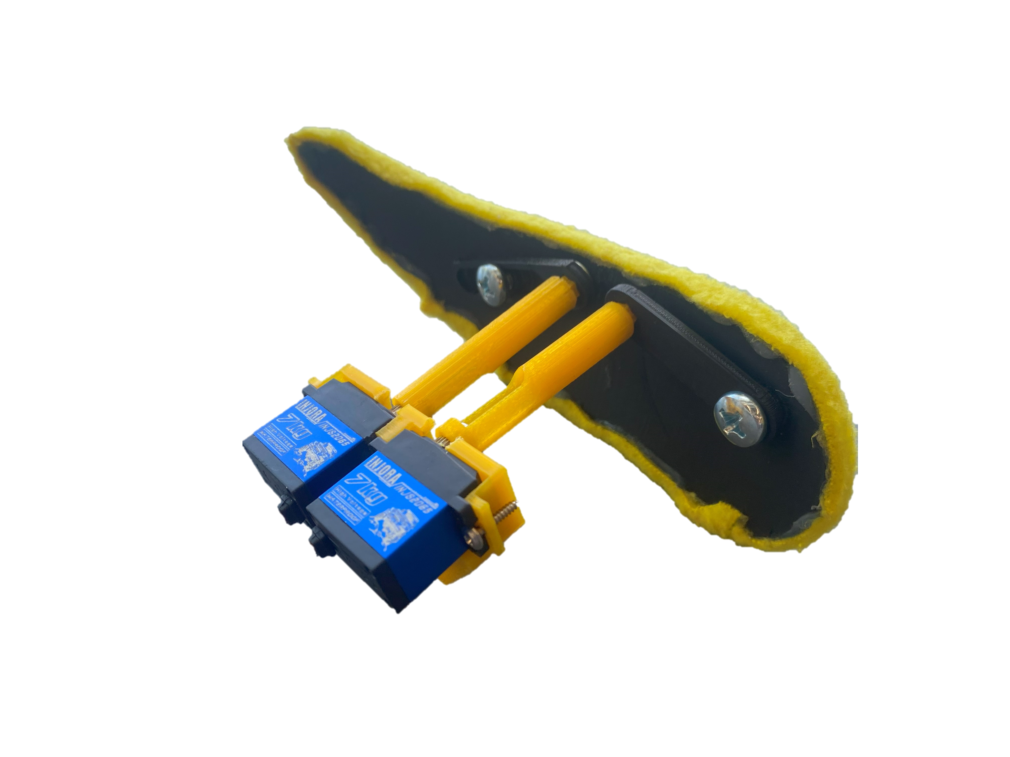
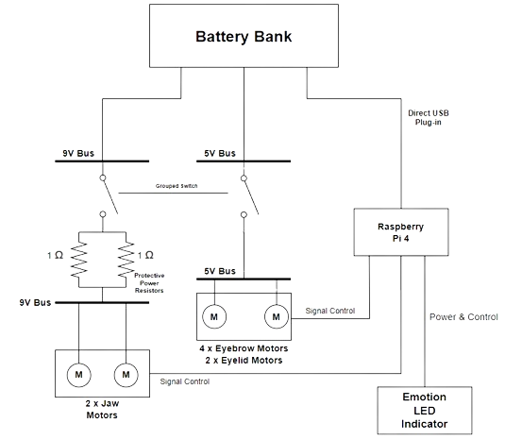
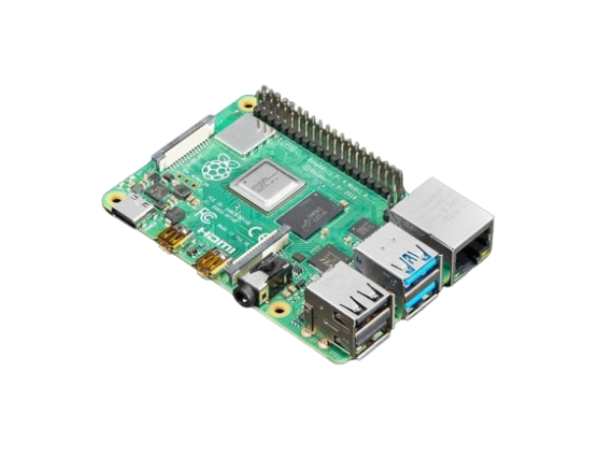
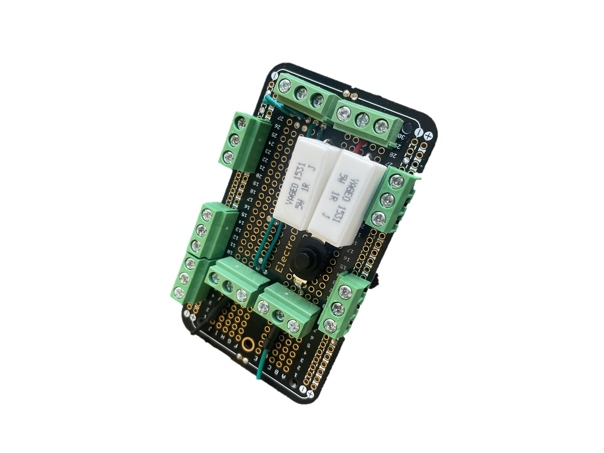
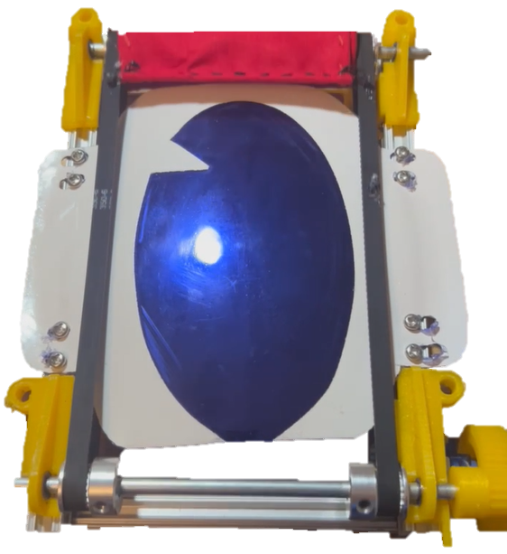
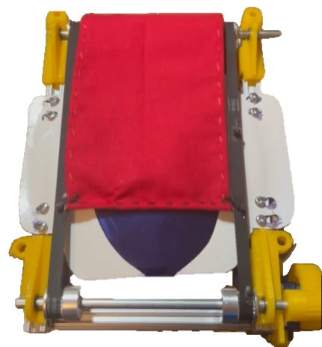
Junior Jay
Luke Jansen, Scott Klein, Josh Ryan, Jake Eggleston
Project Goal
Facial Detection Software
Mechanical Mechanisms
Develop a Jayhawk mascot animatronic with dynamic facial expressions for better live audience interaction, controlled by the wearer's facial movements
Custom ML model uses camera stream to detect wearer emotion in real time
Mechanical mechanisms controlled based on detected emotion
Beak:
Open/close to simulate smile or shock
Two high-torque servo motors move lightweight Al frame fixed to lower beak
Eyebrows:
Nuanced Rotation that reflects variety of emotions
3-bar linkage design, two hidden servos mounted inside head, with shafts protruding through forehead that spin links
Eyelids:
Open/close to simulate blinking
Custom thermoformed plastic coated with one-way mirror film
Belt-driven mechanism spins fabric (eyelid) by continuous servo motor
Limit switches send signal to shut off motor when fully open/closed
Electrical System
50,000mAh battery pack with 2hr. Lifetime
Raspberry Pi GPIO pins provide signal to servos based on facial detection software
LED Panel indicates detected emotion
Raspberry Pi 4
Custom 5V/9V Power Bus

